Slide 1
Task 4: Dashboard Design Objective: Design an interactive dashboard for business stakeholders . Tools: Power BI / Tableau Deliverables: Interactive Dashboard + PPT summary

Slide 2
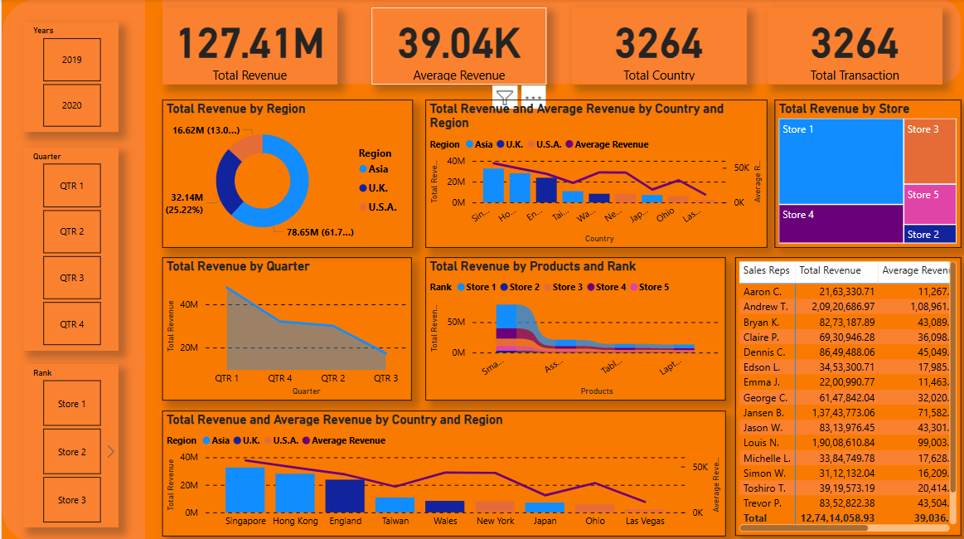
SALES FINANCIAL ANALYSIS DASHBOARD

Slide 3
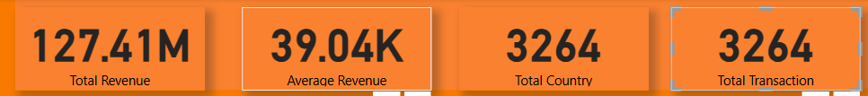
The image displays four cards, each presenting different metrics: Total Revenue: 127.41MThis card indicates the total revenue, which is 127.41 million. Average Revenue: 39.04KThis card shows the average revenue, which is 39.04 thousand. Total Country: 3264This card displays the total number of countries, which is 3264.Total Transaction: 3264This card shows the total number of transactions, which is 3264.

Slide 4
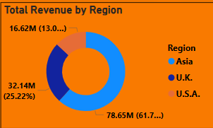
This image displays a breakdown of total revenue by region, presented in a donut chart format. The chart shows three regions: Asia, U.K., and U.S.A., each represented by a different color. The U.S.A. region has the largest revenue at 78.65M, accounting for 61.7% of the total revenue. The U.K. region has a revenue of 32.14M, which is 25.22% of the total. Finally, the Asia region has the lowest revenue at 16.62M, accounting for 13.0% of the total revenue

Slide 5
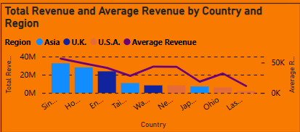
This image presents a combination bar and line chart visualizing total revenue and average revenue across different countries and regions. The chart is titled "Total Revenue and Average Revenue by Country and Region" and displays data for Asia, the UK, and the USA. The total revenue is represented by blue bars, while the average revenue is shown as a purple line. The countries listed on the y-axis include Sin, Ho, En, Tai, WA, Ne, Jap, Ohio, and Las. The chart indicates that Asia has the highest total revenue, followed by the U.K. and U.S.A. The average revenue, depicted by the purple line, shows that while Asia's total revenue is high, its average revenue is less than that of the U.S.A., which has the highest average revenue. The countries listed on the y-axis have varying total revenues, with some having very low revenues.

Slide 6
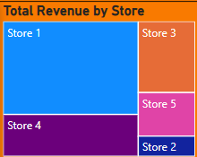
This image shows a visual representation of total revenue by store. Store 1 has the largest revenue, followed by Store 3. Store 4 has the third-highest revenue, then Store 5, and finally, Store 2 has the lowest revenue.

Slide 7
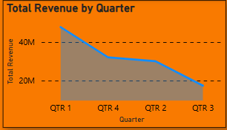
Total Revenue by Quarter: A line graph shows revenue trends over four quarters. Revenue starts around 40M in QTR 1, dips to around 10M in QTR 2, and then rises to a bit over 20M in QTR 4.The graph has a noticeable drop in revenue between QTR 1 and QTR 2. Total Revenue by Country and Region: A bar chart displays the total revenue broken down by region (Asia, UK, USA) and average revenue. The average revenue bar is shorter, suggesting it's an average across multiple regions. Total Revenue by Products and Rank: A bar chart shows total revenue for different products. The chart has a ranking of stores, indicating a store-level breakdown of revenue.

Slide 8
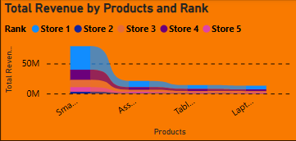
This image displays a stacked area chart illustrating total revenue by product across five different stores. The vertical axis represents the total revenue, with a scale from 0M to 50M. The horizontal axis lists the different products, categorized as "Smartphone", "Accessories", "Tablet", and "Laptop". Each store is represented by a different color, allowing for a visual comparison of revenue contribution by product across stores. The chart's title is "Total Revenue by Products and Rank."

Slide 9
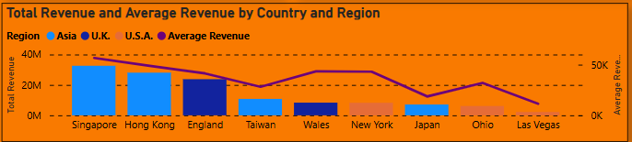
This image displays a combination of bar and line graphs illustrating total revenue and average revenue across various regions and countries. The bar graph represents the total revenue for each location, while the line graph depicts the average revenue. The locations are listed on the vertical axis, and the revenue amounts are on the horizontal axes. The total revenue is measured in millions (M), while the average revenue is measured in thousands (K). The color coding distinguishes between regions: Asia, UK, and USA. The line graph shows a trend of average revenue over the locations. The highest total revenue is in the Asia region, specifically Singapore and Hong Kong. The average revenue is generally lower for the locations within the USA.

Slide 10
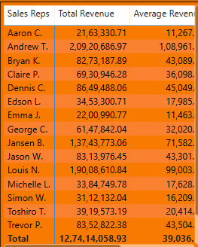
This image presents a sales performance report, displaying data for various sales representatives. It includes columns for "Sales Reps," "Total Revenue," and "Average Revenue." The report lists each sales representative's name, followed by their total revenue generated and the average revenue per transaction. The data is presented in a table format, with a total row at the bottom summarizing the overall figures. The sales representatives are: Aaron C., Andrew T., Bryan K., Claire P., Dennis C., Edson L., Emma J., George C., Jansen B., Jason W., Louis N., Michelle L., Simon W., Toshiro T., and Trevor P. Their total revenue ranges from 21,63,330.71 to 2,09,20,686.97, while average revenue varies from 11,267 to 108,961. The total revenue for all sales representatives is 12,74,14,058.93, with an average revenue of 39,036.

Slide 11
THANK YOU

